Slide 1
Tobacco Store
Class Name: PF1121
Group Name: Group 10
Intructor: Nguyen Xuan Sinh
Member: Vu Cong Nguyen
Tran Ngoc Hai

Slide 2
Introduction to Project
This system will provide some basic features including:
There are 2 main features include create order, confirm payment or cancel order
Which include additional features such as view tabacco list, search tabacco, view order list, wier order details.

Slide 3
Customer Requirements
Seller login
Show Tabacco
Create order
Show order
Confirm pament or cancel order

Slide 4
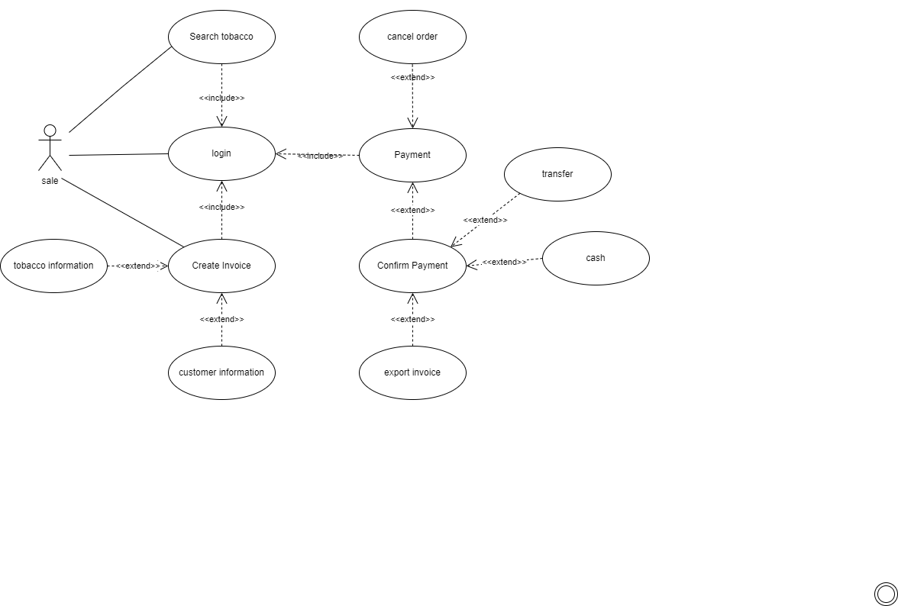
Use Case
Use Case

Slide 5
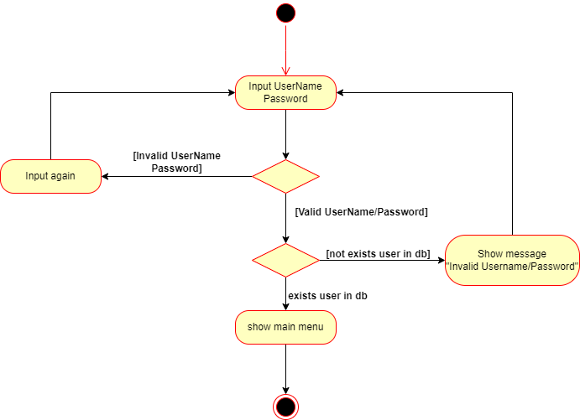
Activity Diagram
Login

Slide 6
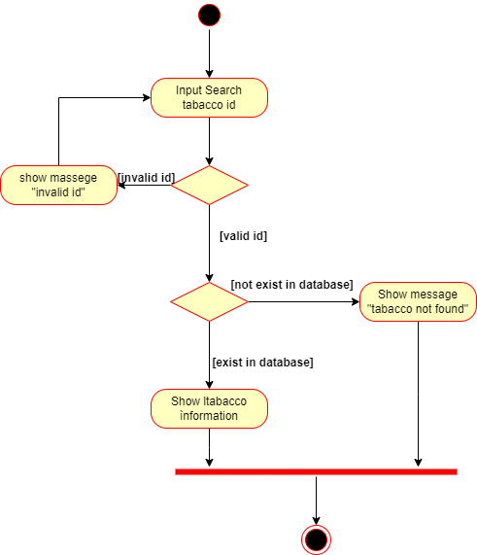
Activity Diagram
Search Tobaccos

Slide 7
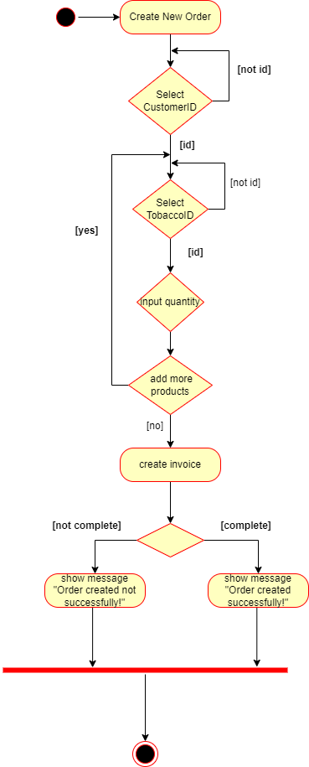
Activity Diagram
Cancel Order

Slide 8
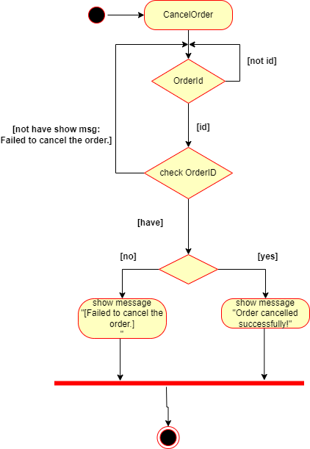
Activity Diagram
Cancel Order

Slide 9
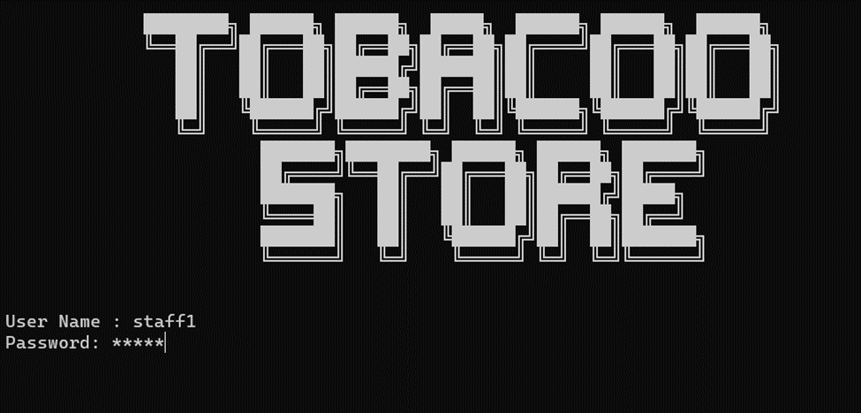
UI Design
Login

Slide 10
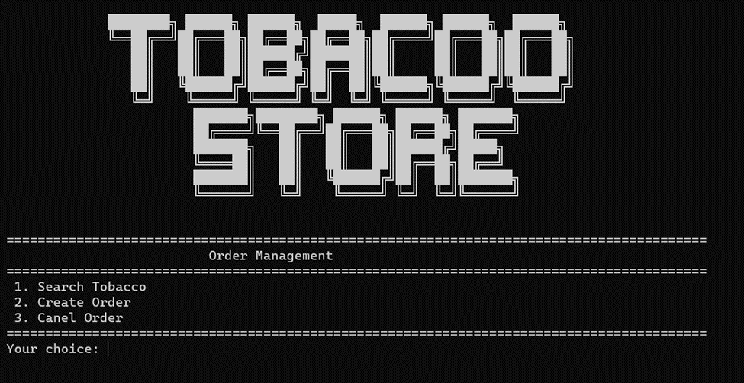
UI Design
Order Management

Slide 11
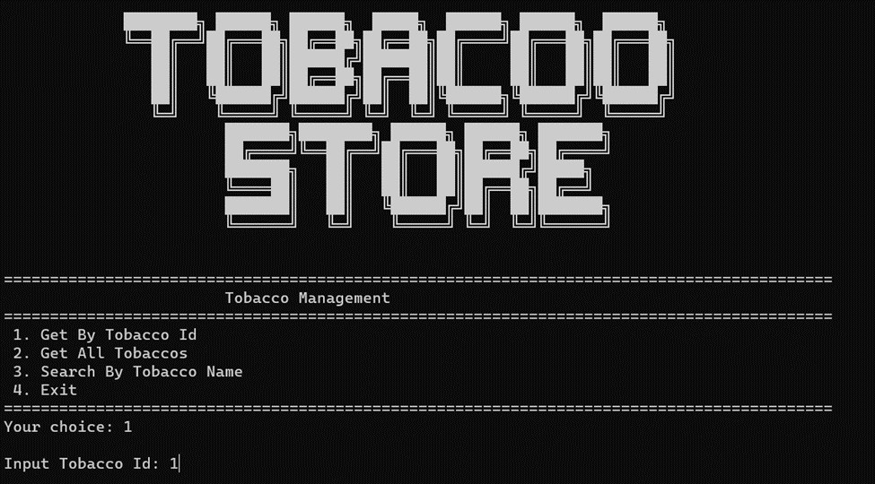
UI Design
Get by Tobacco Id

Slide 12
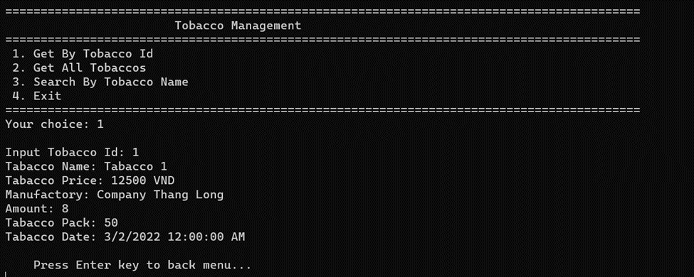
UI Design
Show Tobaccos

Slide 13
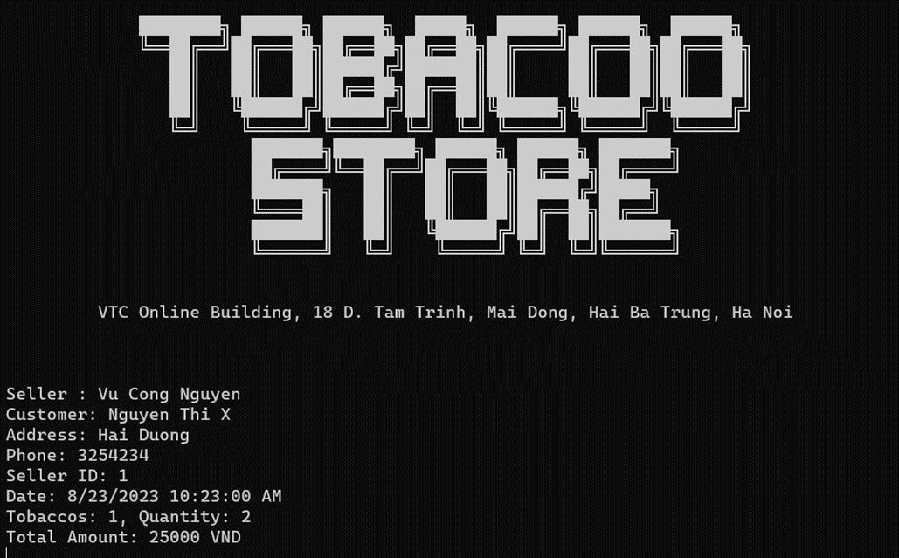
UI Design
Invoice

Slide 14
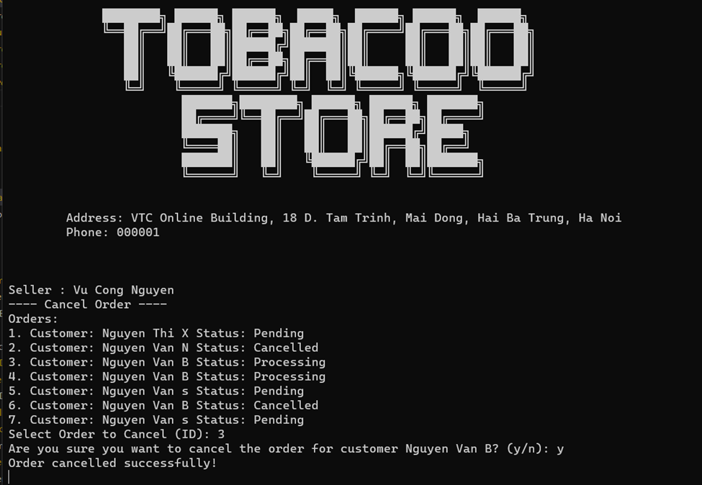
UI Design
Cancel Order

Slide 15
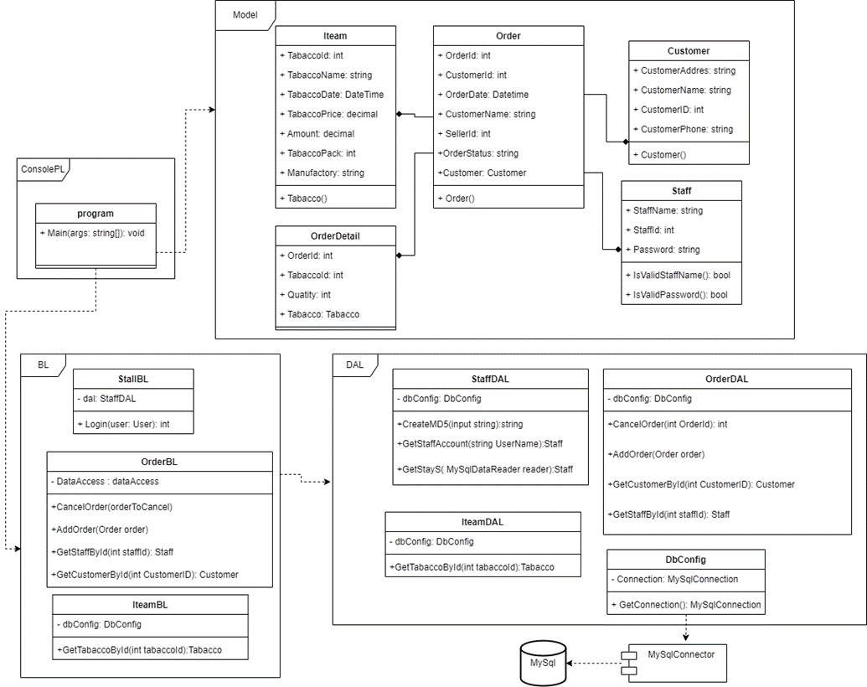
Class Diagram

Slide 16
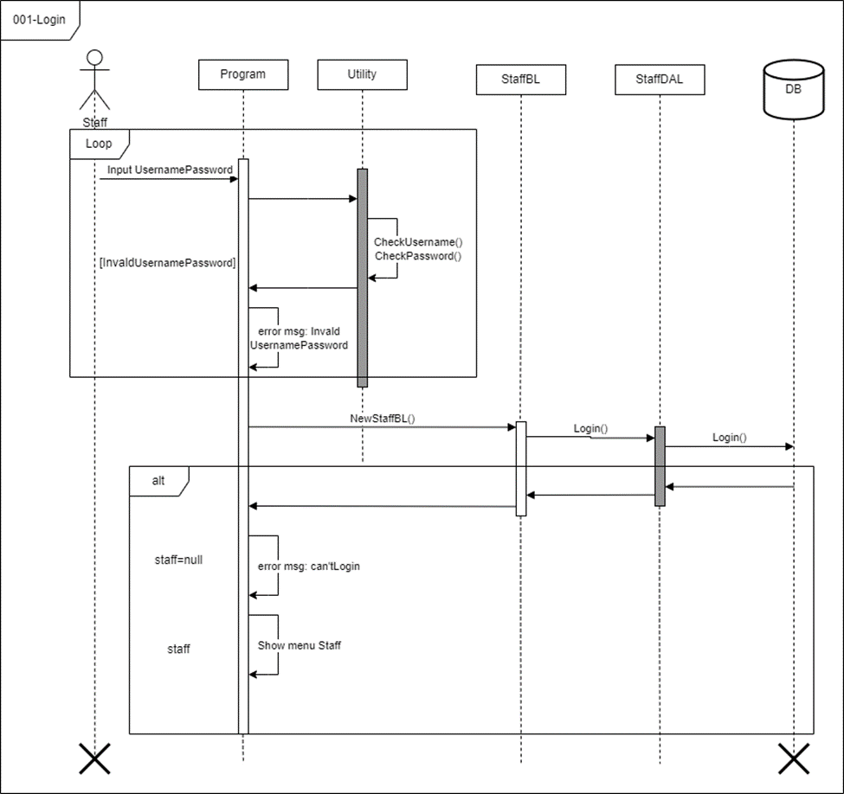
Sequence Diagram
Login

Slide 17
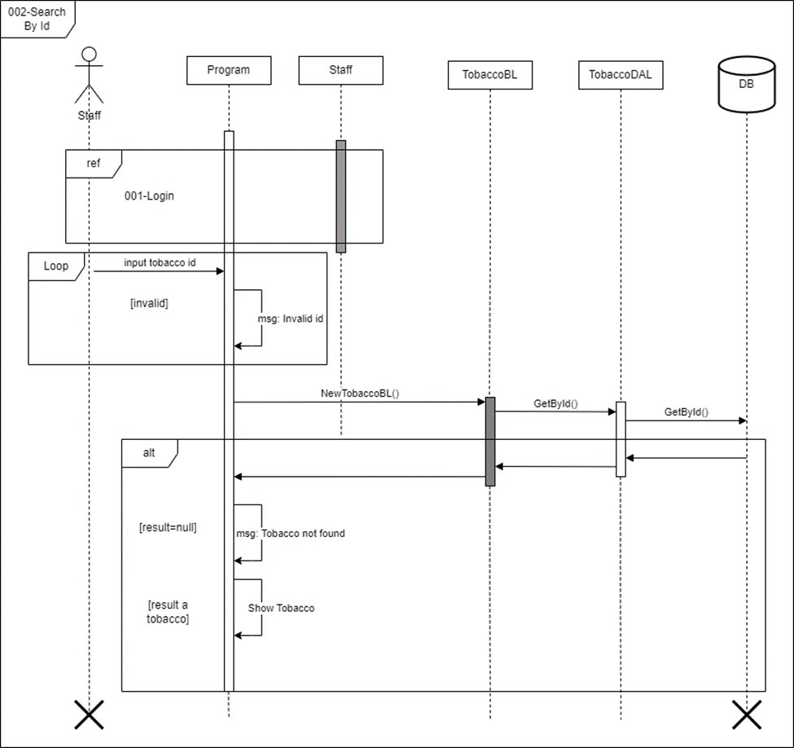
Sequence Diagram
Search Tobaccos

Slide 18
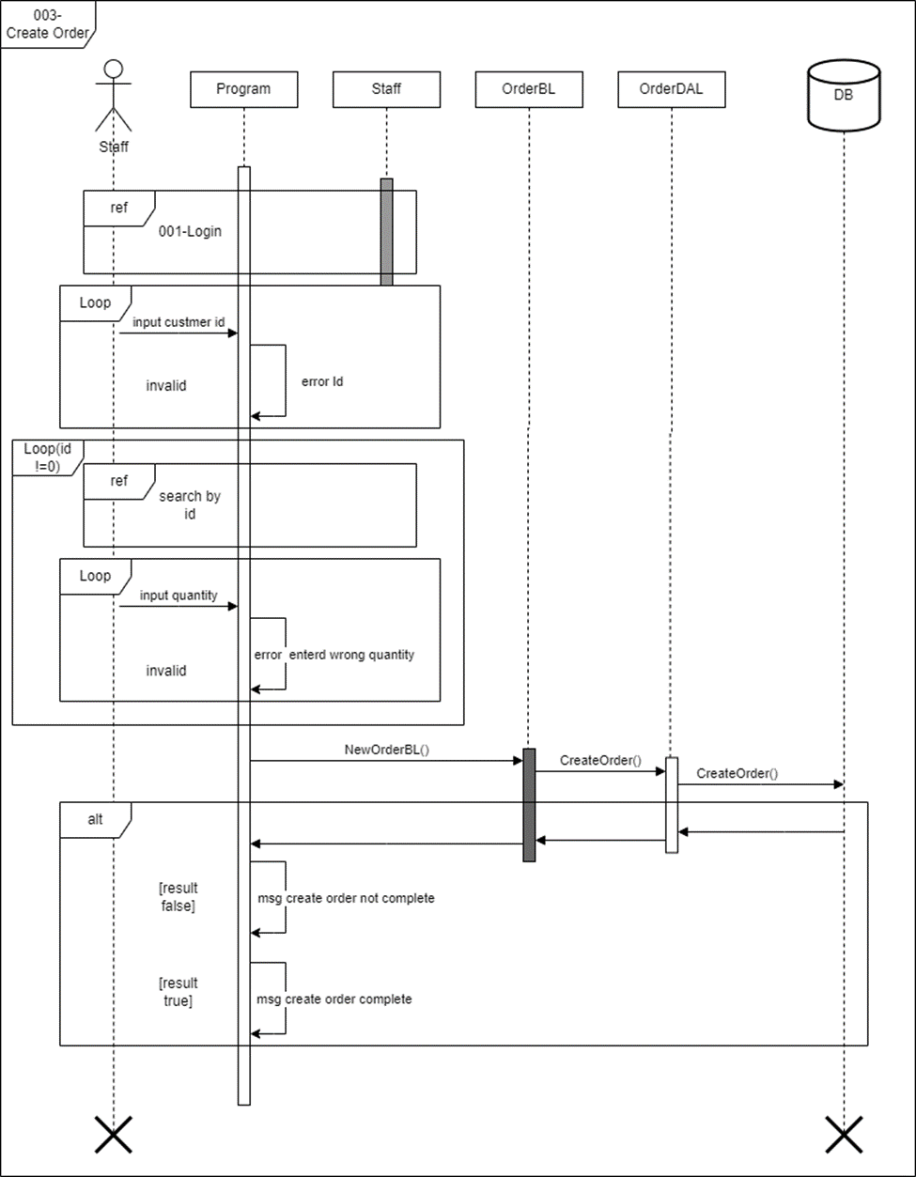
Sequence Diagram
Create Order

Slide 19
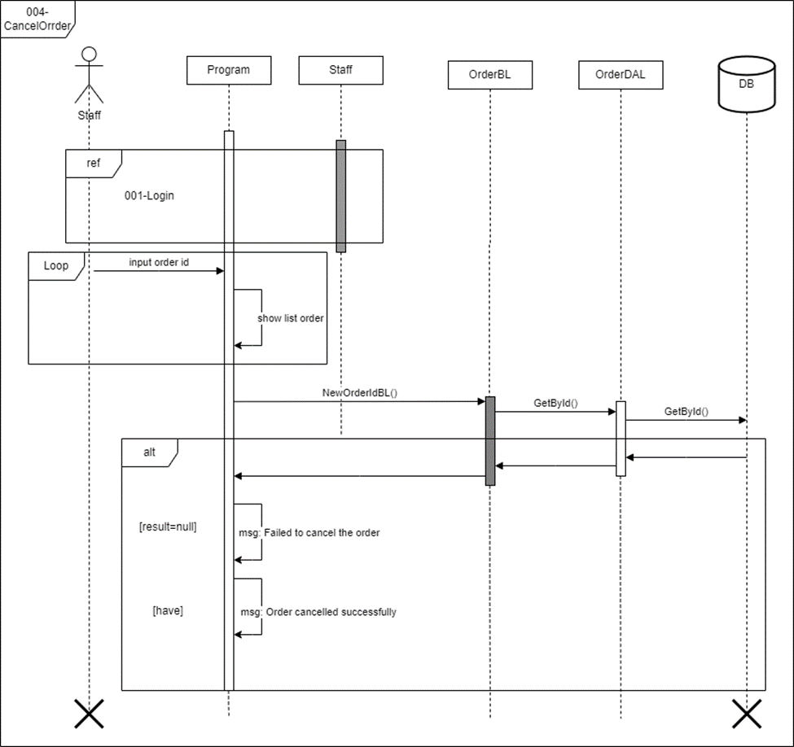
Sequence Diagram
Cancel Order

Slide 20
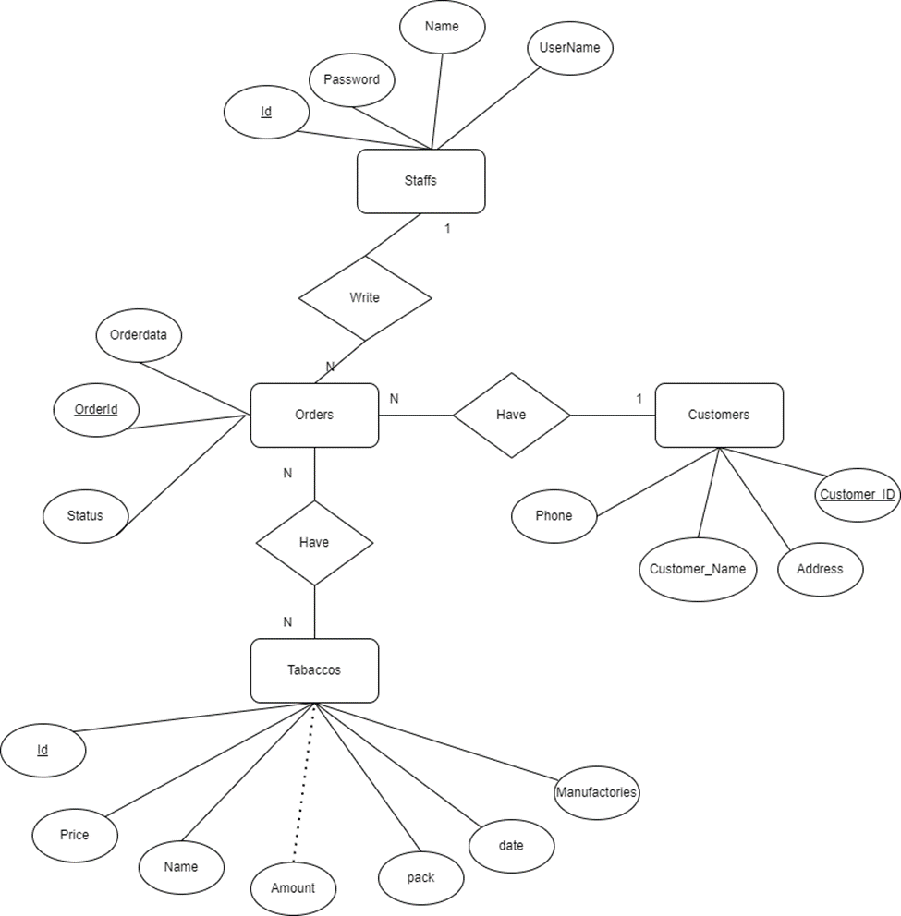
Entity Relationship Diagram

Slide 21
Experience Learned
Grasp most of the first semester knowledge, especially object-oriented programming and databases.
Understand and capture the project process.
Understand the importance of teamwork skills,
work online, know the basic mistakes often encountered in coding.

Slide 22
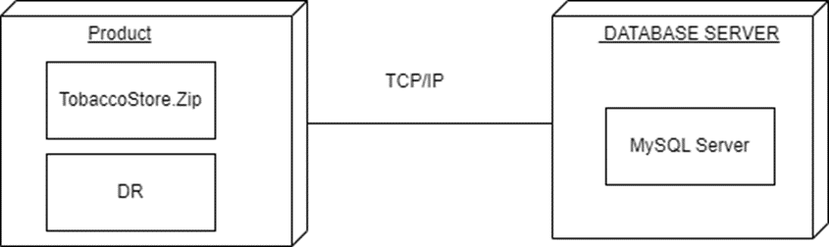
Installation Instructions
Deployment Diagram

Slide 23
Installation Instructions
Database Install
Downloat MySQL Community Sever in website
https://dev.mysql.com/downloads/installer/
Application install
Click on this link to download
https://drive.google.com/drive/folders/1nrd2g248yGCrIvfsmatDcZ-SH7q4SFy3

Slide 24


Slide 25
Q & A

